Slide 1
STIBO Introduction & Education Pack
Member of Walgreens Boots Alliance ©2023 Walgreen Co. All rights reserved.

Slide 2

Agenda
1
What is Master Data at Walgreens?
2
Accessing and Utilizing STIBO
3
Resources and Support Information
4
Appendix

Slide 3
Master Data at Walgreens

Slide 4

What is Master Data at Walgreens?
Master data is the consistent and uniform set of identifiers and extended attributes that describes the core entities of the enterprise including customers, prospects, citizens, suppliers, sites, hierarchies and chart of accounts.
Master Data Drives Our Integrated Business Processes
  Used across multiple functions at Walgreens
  At the core of Walgreens business activities such as:
    Purchase Orders
    Supplier Payments
    Inventory Valuation
    Inventory Locations
    Financial Reporting and Auditing
Closing the Books
Listing & Catalog
Master Data
Paying Suppliers
Inventory Planning
Selling to Customers & Reporting
Store Receiving
Pricing & Promotions

Slide 5
Data Accuracy
Why 100% Data Accuracy matters in your end to end journey
Suppliers are required to have 100% accurate data, from supplier master data, order/EDI ASN/invoices, to items/costs/catalogs. SAP systems require more effort across many different teams to troubleshoot issues so data accuracy is critical.
There is a large impact if data is inaccurate, ranging from store receiving to payment issues.
There is a ripple effect: If you fail to keep your contacts up to date, you will miss important communication including time-sensitive notifications to avoid payment delays, advance ship notice (ASN) failures, etc.
If an item isn’t in the catalog, Walgreens will not be able to order/receive, which can also result in the full invoice failing and not being paid.

Slide 6
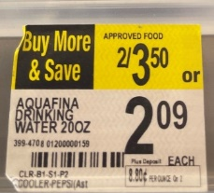
Article Master Data
What is it?
Contains detailed information at a granular level for each Item that Walgreens procures, produces, inventories, and sells
Includes:
  Procurement cost & where we purchase it from
  Retail price & which stores can carry it
  Description to display on shelf mylar tag in store
  Description to display on customer receipt
  Size/weight (important for calculating freight costs)
  Unit of Measure (count, e.g., each, case-pack, etc.)
  Replenishment threshold/reorder quantity
  Special handling requirements (flammable, aerosol, hazardous material, etc.)
Impact of getting it wrong
Article dimensions incorrect:
  Item may not fit on store shelf
  Item may not be able to be received into our stores or warehouses
Article description incorrect:
  Shelf mylar prints with incorrect item information
  Can result in fines for misrepresenting an item to customer

Slide 7
Vendor Master Data
What is it?
Data record for all Walgreens suppliers
Supports functions for creating/ maintaining suppliers and purchase orders
Directly impacts main logistics processes like:
  Plan to Purchase
  Procure to Pay
  Manage Finance (accounts payable process)
Includes:
  Vendor Address
  Lead times
  Tax ID
  EDI Information
  Payment terms
  Contact Information
Impact of getting it wrong
Incorrect Vendor Contact or Banking Information:
  Delays vendor payment

Slide 8
Accessing and Utilizing STIBO

Slide 9
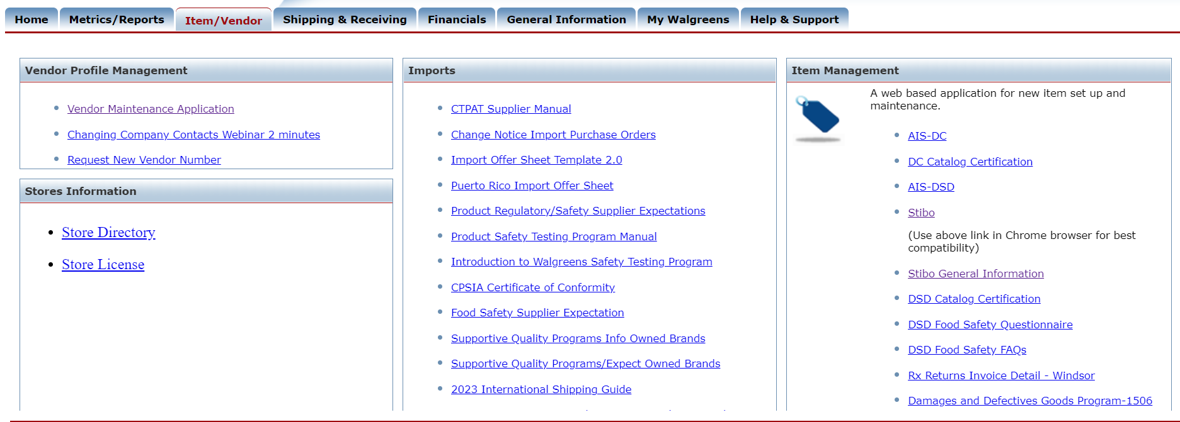
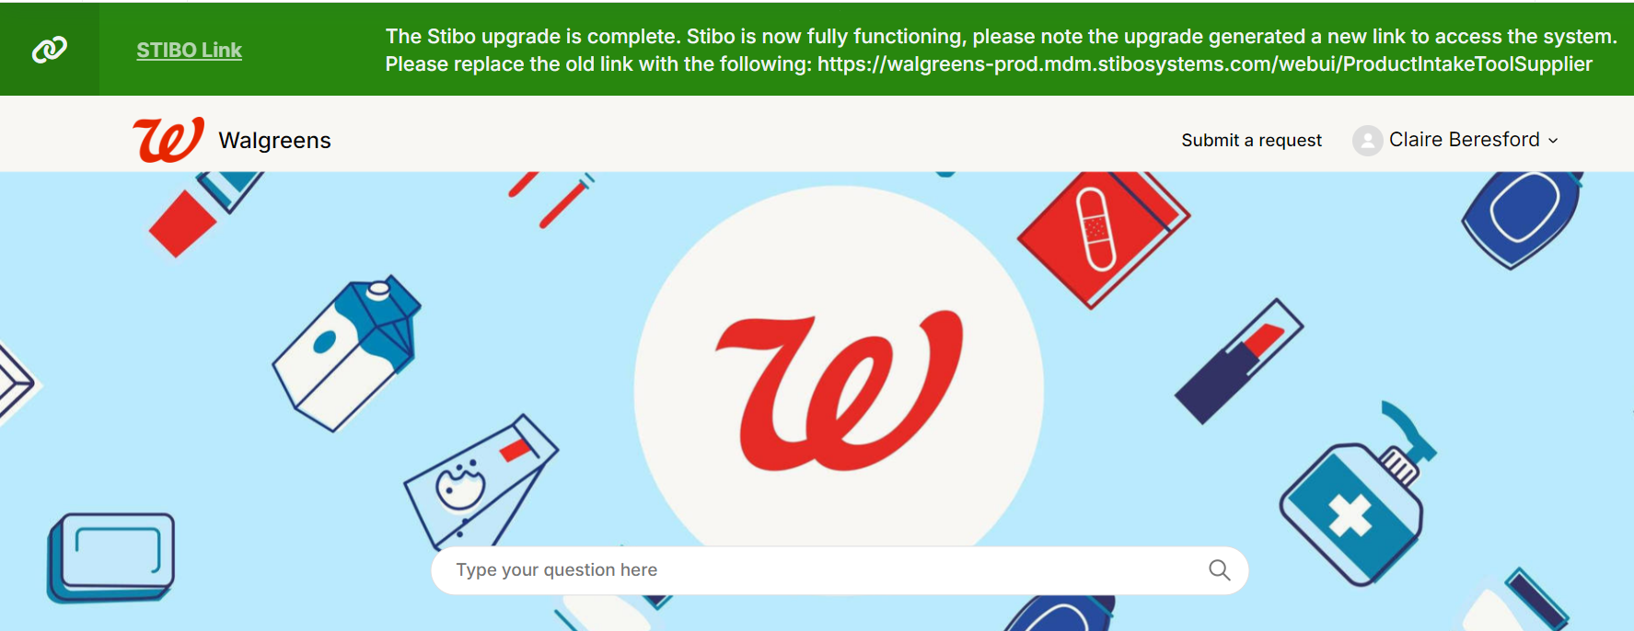
Accessing Stibo
Access via SupplierNet
  (Item/Vendor tab -> Item Management section)
2. Access Via Zendesk
Access using the direct link
  https://walgreens-prod.mdm.stibosystems.com/webui/ProductIntakeToolSupplier
*IMPORTANT: You (Suppliers) WILL NOT have access to Stibo until you are notified via email that you have access to the system.
Please reference slides 33-52 in the Appendix on initial SupplierNet set up and login
Notes:
In the appendix there will be more information on how to register for supplier net.
Zendesk is a helpful tool with a direct to Stibo. This site also encompasses many of our Stibo related job aids. I will talk about this more towards the end of this session
Access to Stibo is in not granted until you reveive a email.

Slide 10
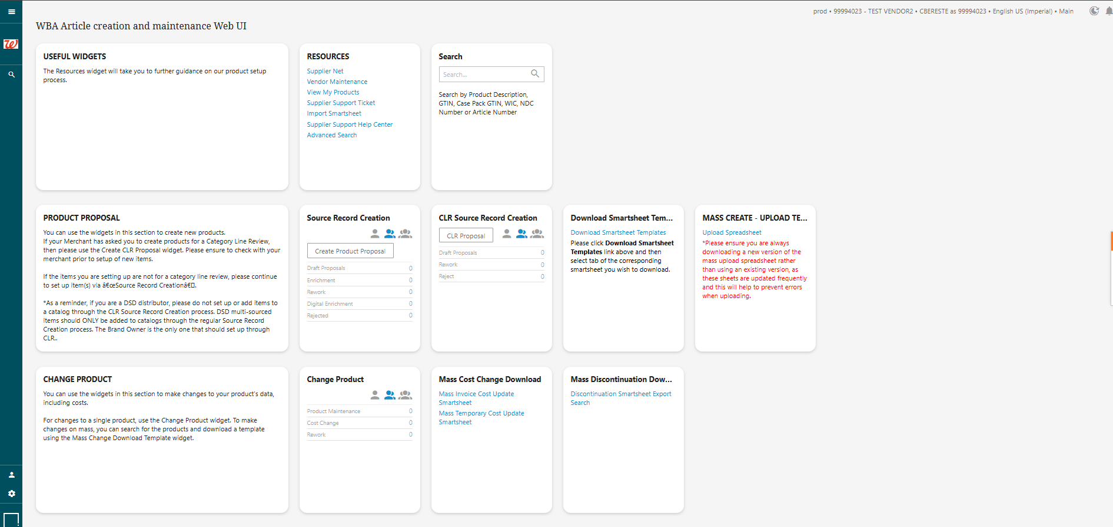
Stibo Home Screen Overview
Notes:
In the next few slides, we’ll review the Sibo home screen
Things to call attention to right off the bat:
- We will review this more in depth in another slide but notice how the home screen is divided into three different rows, the tiles in each row perform similar functions
- The button on the left that will take you back to the home screen
- Walkme tool

Slide 11
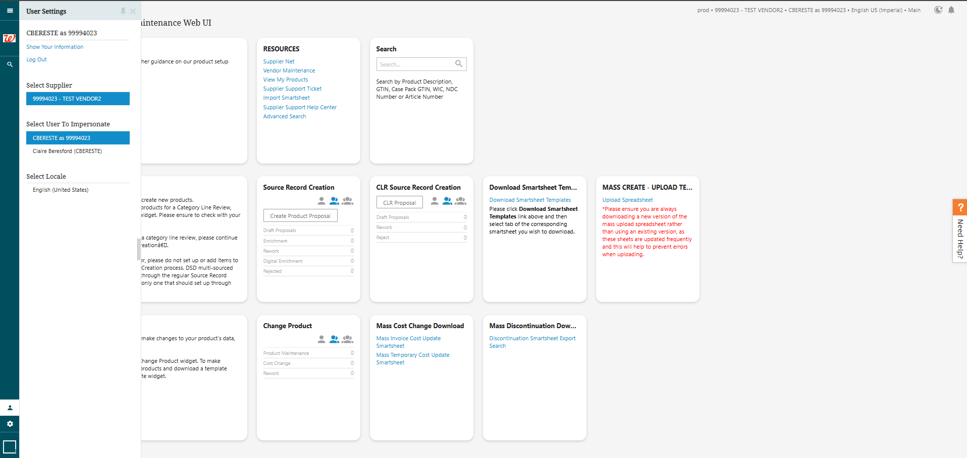
Ensure you see the correct SAP Supplier Number and ONE ID
Before getting started with proposals or maintenance, ensure you see the correct Supplier Number displayed in the top right-hand corner of the Stibo Dashboard.
Please reference slides 60-62 in the Appendix on vendor number explanations
Notes:
If you represent more than one Supplier (e.g., Brokers, etc.), you will have the option to toggle to the correct Supplier Number before starting proposals or conducting maintenance
To check if you are under the correct supplier ID, you can verify in the upper right corner
If you are not under the correct ID, select the person icon at the lower left corner and adjust accordingly
If you do not know your SAP or Legacy ID, you can select the ‘show your information’ in this tab and it will give a break down of each vendor number you have access to

Slide 12
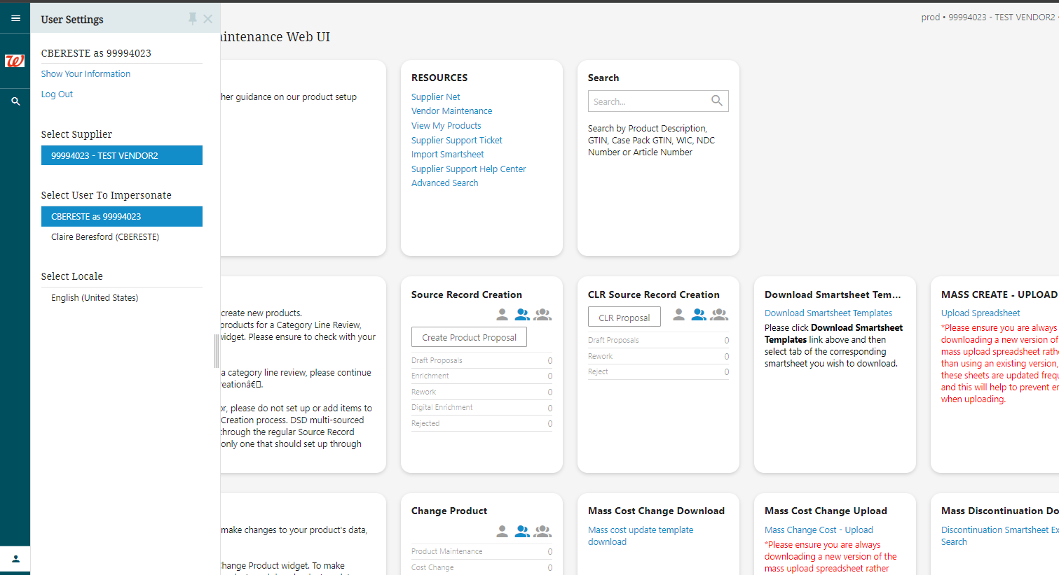
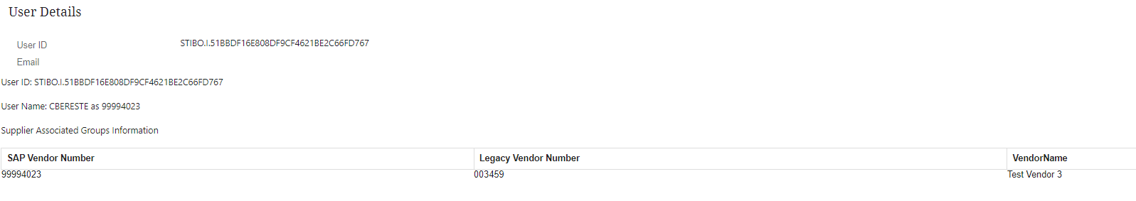
Ensure you see the correct SAP Supplier Number and ONE ID
Please reference slides 60-62 in the Appendix on vendor number explanations

Slide 13
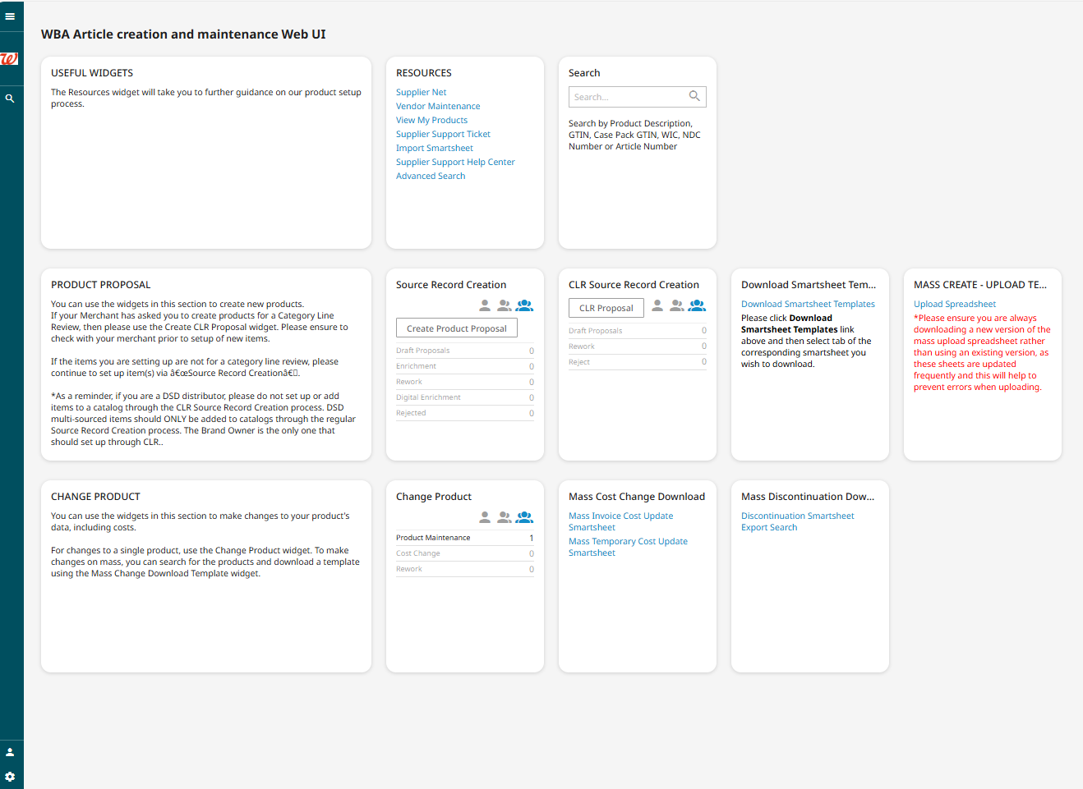
Stibo Home Screen Overview
Useful Widgets
This section is used to reference various resources and search for your items within Stibo
Product Proposal
Navigate to this section to initiate or work on an item before it is fully set up and approved
Change Product
This section is used for any changes after an item is fully set up and approved
Notes:
Right off the bat to call out:
The home screen is organized in 3 sections, each section serves its own purpose
Useful Widgets
This section is used to reference various resources and search for your items within Stibo
The search function is also part of this section
This is how you will search for your items in stibo
You can search for all your items here regardless of the workflow
Product Proposal
This product proposal section is where you will find your item throughout its creation process
You can see we have a few different ways to set up or initiate an item
Source record creation
CLR Source record creation
Smartsheet – Mass creation
Please note: your merchant will be in contact with you regarding the correct process to use during item set up
Change Product
This section is used for any updates POST approval
After you item has been set up and fully approved and you wan to change the cost, this is where you would do it
A few things to call out
You will hear people mention the ‘queue’ your item is in, they are referring to the sections within each widget
Lets say your item that you initiated via Source record creation, is currently being set up, it is past the draft proposals section but is now in the enrichment queue, you would navigate to the product proposal section and the source record creation widget and find the enrichment queue here

Slide 14
Accessing and Utilizing STIBO
Product Proposals

Slide 15
Product Proposals
Product Proposal
Navigate to this section to initiate or work on an item before it is fully set up and approved
Notes:
Right off the bat to call out:
The home screen is organized in 3 sections, each section serves its own purpose
Useful Widgets
This section is used to reference various resources and search for your items within Stibo
The search function is also part of this section
This is how you will search for your items in stibo
You can search for all your items here regardless of the workflow
Product Proposal
This product proposal section is where you will find your item throughout its creation process
You can see we have a few different ways to set up or initiate an item
Source record creation
CLR Source record creation
Smartsheet – Mass creation
Please note: your merchant will be in contact with you regarding the correct process to use during item set up
Change Product
This section is used for any updates POST approval
After you item has been set up and fully approved and you wan to change the cost, this is where you would do it
A few things to call out
You will hear people mention the ‘queue’ your item is in, they are referring to the sections within each widget
Lets say your item that you initiated via Source record creation, is currently being set up, it is past the draft proposals section but is now in the enrichment queue, you would navigate to the product proposal section and the source record creation widget and find the enrichment queue here

Slide 16
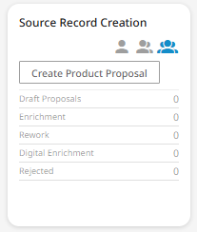
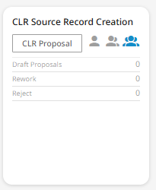
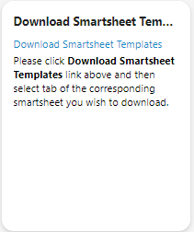
Product Proposals
Standard Product Proposal
CLR Product Proposal
Mass Proposals
Item is fully setup. Suppliers enter all item attributes, and the item is submitted to the merchant team. This item will go through all the approvals and WERCS, if necessary.
Article and WIC are provided at the end of the approval
Item is setup as a “W” or “quick” WIC for Category Line Reviews (CLR). The supplier enters some, but not all the attributes. The items goes to the merchant team for approval. If approved, the item receives a “W” or “quick”
Smartsheets allow for 100% of the Supplier product data to be uploaded; upon upload, Suppliers will either be notified the mass proposal upload was successful or if it included errors and then be prompted to correct the errors and resubmit the upload for Merchant review and approval.
DSD Resources
DC Resources
DSD Resources
DC Resources
Smartsheet Resources
Notes:
Please note: for CLR items, your merchant will initiate this process for you
The decision for standard vs CLR is an internal decision and you will be notified accordingly on which process to utilize

Slide 17
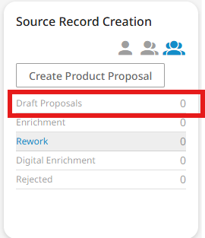

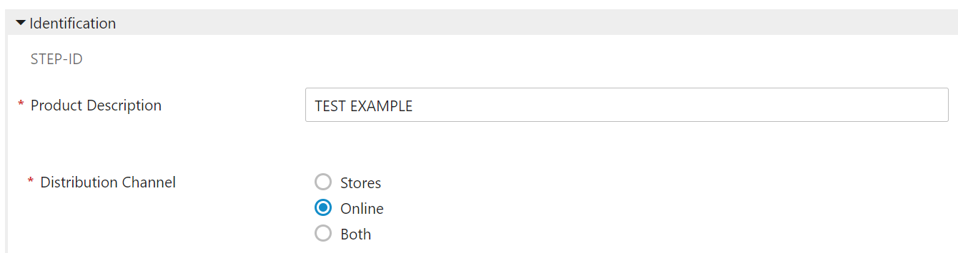
Additional Callouts
Online-Only Product Proposals
Owned Brand Product Proposals
Suppliers can submit online-only product proposals in Stibo, but in these scenarios, Suppliers must work back with Digital Category Manager (DCM) to finalize setup.
Select the “Online” option as the Distribution Channel in Stibo. The validation rules and logic built into Stibo will guide the Supplier on which attributes are required for online-only items.
Owned Brand product proposals can only be initiated by Walgreens Global Sourcing Managers (GSMs) and are directed to ‘Suggested Suppliers’ in the Stibo system.
Suppliers are expected to monitor their product proposal and maintenance queues regularly in Stibo, this is especially important for when GSMs send product proposals to a suggested Supplier, which will be found in the draft proposals queue.
Notes:
Online Only
Once Suppliers submit the online-only product, the Supplier and DCM must continue to finalize product setup.
Additionally, if submitting a proposal as “Both” store and online, the proposal will flow to the DCM for enrichment and approval, then the Supplier and DCM should work together to finalize product setup.
Owned Brand:
Note: Upon receiving the pre-proposal from GSMs, the Suppliers can continue the product proposal setup as they would for any National Brand item, following the steps detailed in the DC job aid on SupplierNet

Slide 18
Accessing and Utilizing STIBO
Product Maintenance

Slide 19
Product Maintenance
Change Product
This section is used for any changes after an item is fully set up and approved
Notes:
Right off the bat to call out:
The home screen is organized in 3 sections, each section serves its own purpose
Useful Widgets
This section is used to reference various resources and search for your items within Stibo
The search function is also part of this section
This is how you will search for your items in stibo
You can search for all your items here regardless of the workflow
Product Proposal
This product proposal section is where you will find your item throughout its creation process
You can see we have a few different ways to set up or initiate an item
Source record creation
CLR Source record creation
Smartsheet – Mass creation
Please note: your merchant will be in contact with you regarding the correct process to use during item set up
Change Product
This section is used for any updates POST approval
After you item has been set up and fully approved and you wan to change the cost, this is where you would do it
A few things to call out
You will hear people mention the ‘queue’ your item is in, they are referring to the sections within each widget
Lets say your item that you initiated via Source record creation, is currently being set up, it is past the draft proposals section but is now in the enrichment queue, you would navigate to the product proposal section and the source record creation widget and find the enrichment queue here

Slide 20
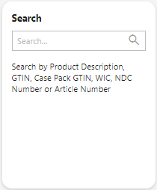
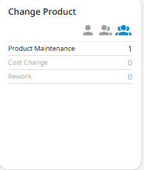
Product Maintenance Changes
Suppliers can modify their existing products from the Stibo dashboard, for both product updates and cost updates.
Use the SEARCH functionality to search for the appropriate, approved Product.
  You can enter the Product Description, the GTIN, the WIC, or the Article Number.
The system shows the results of the search. Select the appropriate Product, select whether it is a Product or Cost update, then navigate back to the Stibo dashboard homepage and find the Product in the Change Product widget.
1
2
Please ensure that your item is not in an active workflow before initiating any changes
3
Notes:
Callout discontinue button

Slide 21
Accessing and Utilizing STIBO
Workflow Overview

Slide 22
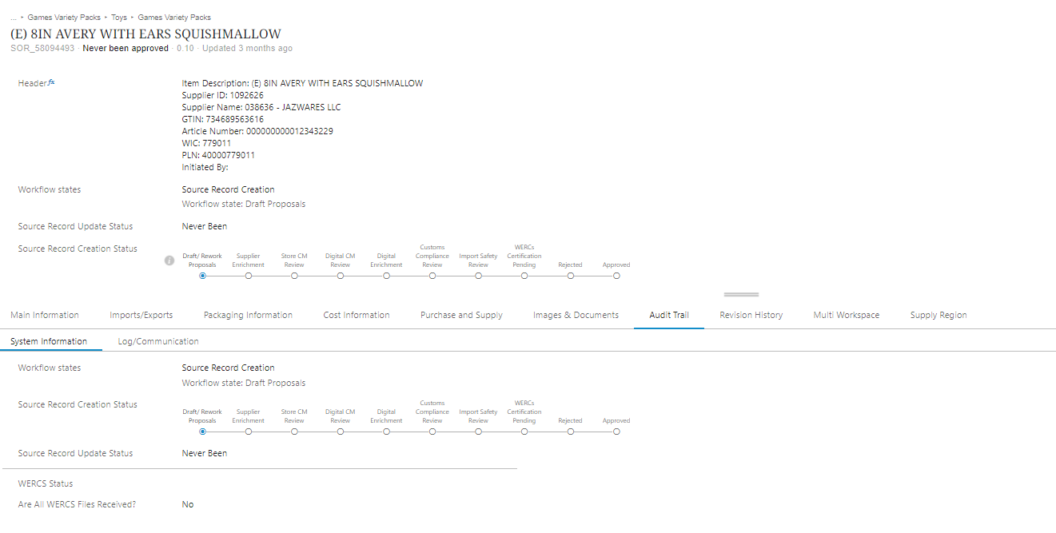
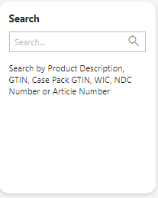
To Find the Status (or ‘workflow’) of an Item in Stibo
Stibo enables Suppliers and Merchants to find the status of their items in the ‘Audit Trail’ tab or header section of any Product in Stibo.
Use the SEARCH functionality to search for the appropriate approved Product. Select the appropriate Product, navigate to the Audit Trail tab and use the “System Information” tab and “Log/Communication” tab to refer to the status.
Notes:
Once the proposal reaches the “Approved” step, a WIC will be generated shortly thereafter and provided to the Supplier and Merchant.
WATCH THIS: https://externalstreaming.walgreens.com/ssl/broadcast/2023/wag/store/how_to_check_workflow_status.html

Slide 23
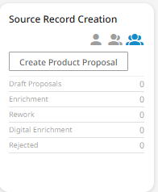
Items sent back to Suppliers for Rework from Merchants
In order to maintain consistent master data governance, Stibo allows Merchants to send product proposals and maintenance requests back to Suppliers for REWORK if there is inaccurate product attribute data.
Walgreens will limit the changes we make and instead will ask Suppliers to correct the proposals themselves.
Suppliers are expected to monitor their product proposal and maintenance queues regularly in Stibo.
Rework: Use this queue to see all the proposals that were asked for rework by the Merchants; these will NOT receive a WIC until they are correct, resubmitted, and then approved by the appropriate Walgreens teams.
Notes:
So at this point in the process lets say you have submitted your draft proposal and are waiting on Merchant approval

Slide 24
Electronic Data Interchange (EDI) 832 for Setup & Maintenance
In addition to manually creating a single Product Proposal, you can also initiate a Product proposal Electronic Data Interchange (EDI) if you are actively publishing data with Walgreens.
Suppliers that subscribe to EDI for item setup and maintenance will not need to access Stibo to complete any enrichment or attribute top-off for items that are submitted.
Exception Scenario: If an item is Sweetened Beverage Fee (SBF), Merchants may ‘Rework’ the proposal back to the Supplier if attribute changes are required, and it will have to be updated in Stibo. However, this will only impact the Parent/Brand Owner (Manufacturer) that will need to complete the rework, not the Distributors/Wholesalers.
Rework: Only applicable in EDI 832 scenarios for parent/brand owners

Slide 25
Resources and Support Information

Slide 26
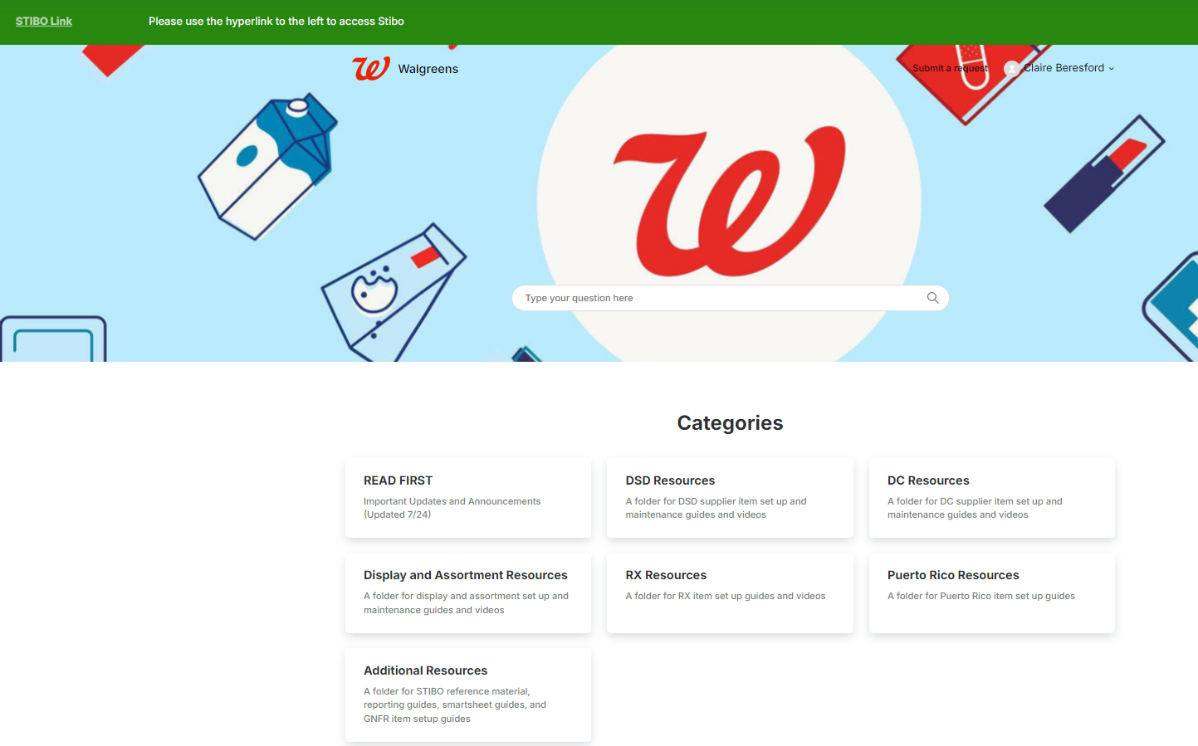
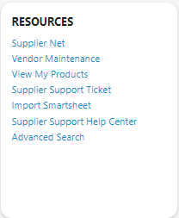
Stibo Support Information
There are several support resources accessible through Stibo and Help Center

Slide 27
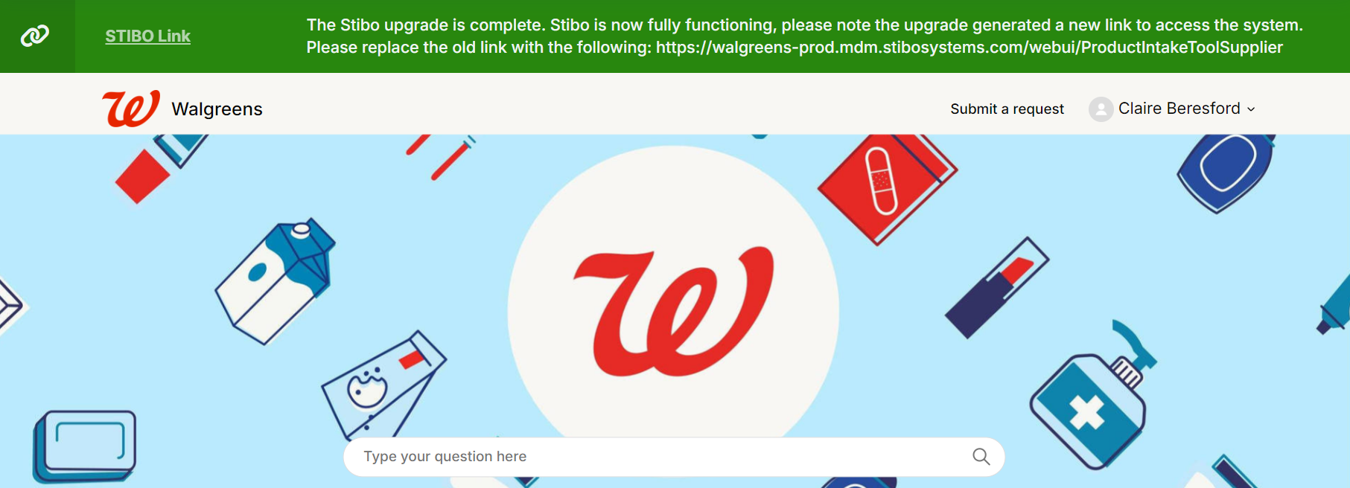
Stibo Support Information – Help Center
If any Suppliers have issues or questions regarding Stibo, refer to the support information below.
For Issues: Utilize the resources available to you, including job aids and videos available Zendesk. Please open a Zendesk ticket using the help center and select ‘Submit a Request’ to submit a ticket
Examples of Reasons to Submit Zendesk Tickets:
Receiving unfamiliar error messages in Stibo
Unable to submit a product proposal
Additional support with item setup
  NOTE: We offer ad hoc calls based on need and availability

Slide 28
General Support Information
SupplierNet Ticket
  With the introduction of Zendesk, this process of opening a ticket in SupplierNet will only be needed for OneId, Password or Non-STIBO related issues. All STIBO related issues should be requested in Zendesk.
  Go to SupplierNet, click ‘Contact us’
  Follow the form prompts and include a detailed description of the issue. Answering all of the information up front will help with resolution.
  Note: Attaching a screenshot of the issue will help expedite a resolution to the problem.

Slide 29

Support Information
Points of Contact: Emails for each Functional area
  EDI Support: For help with overall EDI data requirements edi.support@walgreens.com
    For questions about Notifications email Rejects, EDI810 edi810.rejects@walgreens.com
    For updates to your company EDI contacts to receive proper EDI Invoice Notifications email Production, EDI810 edi810.production@walgreens.com
  Master data Support: itemvendor.support@walgreens.com
  Supply Chain Support: supplier.mgmt@walgreens.com
  Accounts Payable has email boxes for dispute processes
    DC debit note disputes go to danvillevendor.relations@walgreens.com
    DSD debit note disputes go to StoreVendor.Relations@walgreens.com
      DSD You can also contact the team at (217) 554-8989 to speak with a representative
      DSD ERS disputes go to danville.vendorclaims@walgreens.com
  Store Ops – Please connect with your Catalog Owner or Merchandising Assistant/Category Manager to partner with Store Ops leads

Slide 30
Appendix
SupplierNet initial setup and login

Slide 31
New Supplier Account Registration, Updates & Support
Account Administrator
Who should this be?
The first individual who registers from the vendor company during the vendor onboarding process will be designated as the account administrator. Going forward, all users from your company who register in SupplierNet will have to be approved by this account administrator. Note: Additional administrators can be assigned once your vendor number has been activated
Who should not be an administrator?
This should not be a broker, sales representative, or a C-suite individual (unless small business and this person also does administration/operations), but rather an individual who is available and travels less, to approve changes and additional users as part of the vendor account.

Slide 32
New Supplier Account Registration, Updates & Support
Administrator Update
If your administrator needs to be updated or a new one added, please open a support ticket. Click “contact us”, complete the form, and indicate the account administrator needs to be updated (https://suppliernet.walgreens.com > Contact Us > Contact Help Center)
In the form, please provide the full name and email address of the new administrator of your company account (it should be a long-term person in your organization who can be available to approve other users at your company going forward). *Please attach the written approval of establishing a new administrator from your supervisor. An email attachment of approval will suffice.

Slide 33
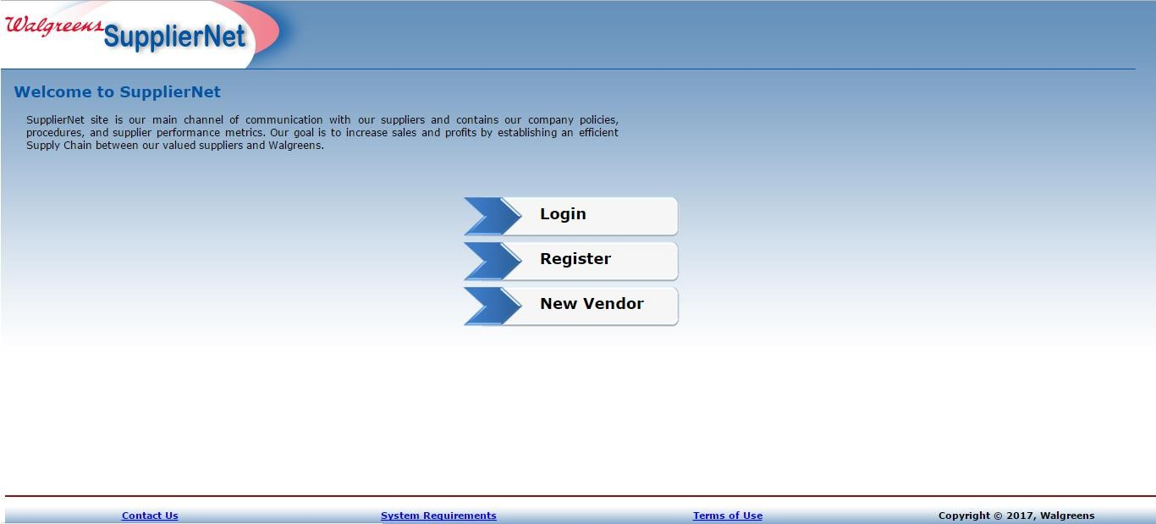
New Supplier Account Registration, Updates & Support
Steps for Registering as a new user
1. Go to the SupplierNet homepage: https://suppliernet.walgreens.com
2. Click ‘Register’ on the SupplierNet homepage to register yourself as a new user (Using your name and company email address).

Slide 34
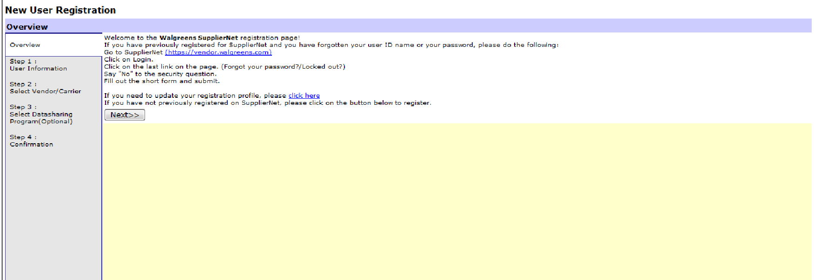
New Supplier Account Registration, Updates & Support
Steps for Registering as a new user
3. The ‘New user registration’ screen will open up after you click ‘Register’. Click ‘Next’ to continue.

Slide 35
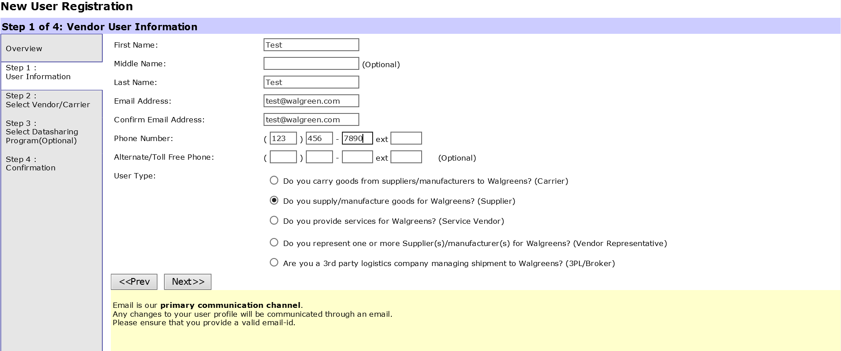
New Supplier Account Registration, Updates & Support
Steps for Registering as a new user
4. On the below screen, please enter your details and choose the appropriate User Type. Click ‘Next’.

Slide 36
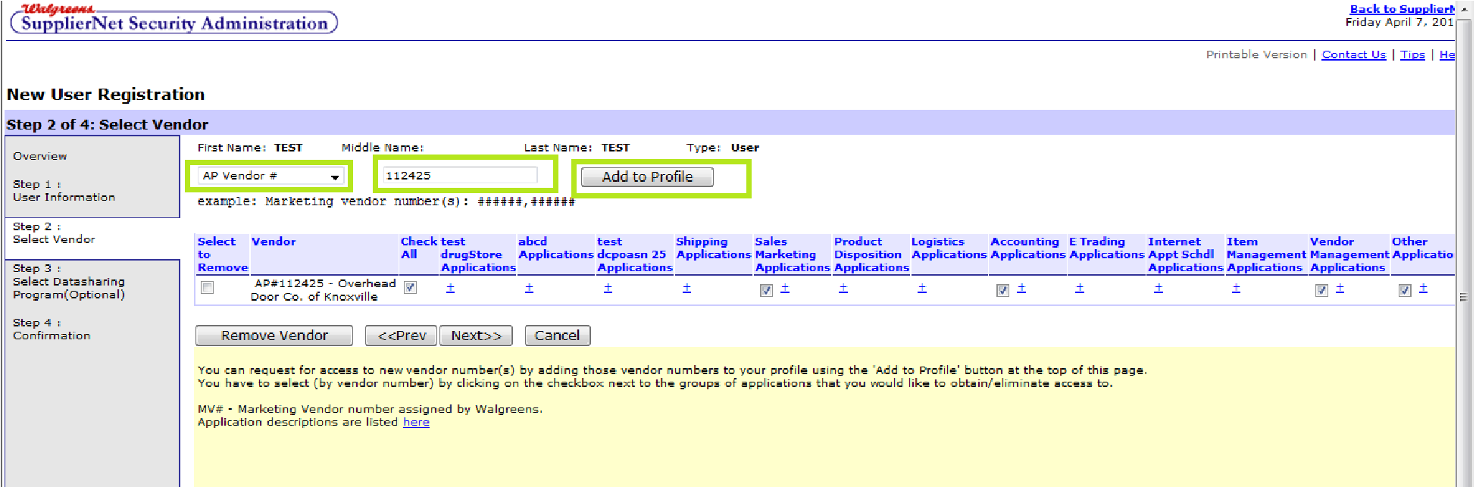
New Supplier Account Registration, Updates & Support
Steps for Registering as a new user
5. Provide your vendor number.
  a. You can separate up to five marketing vendor numbers with a comma.
  b. Select ‘MV Vendor #’ from the dropdown on the below screen, enter your vendor number in the text field and click the ‘Add to Profile’ button.
Note: The AP vendor # will be the accounts payable # for Service Vendor types.
6. Check all the applications that you will need access to then click ‘Next’.

Slide 37
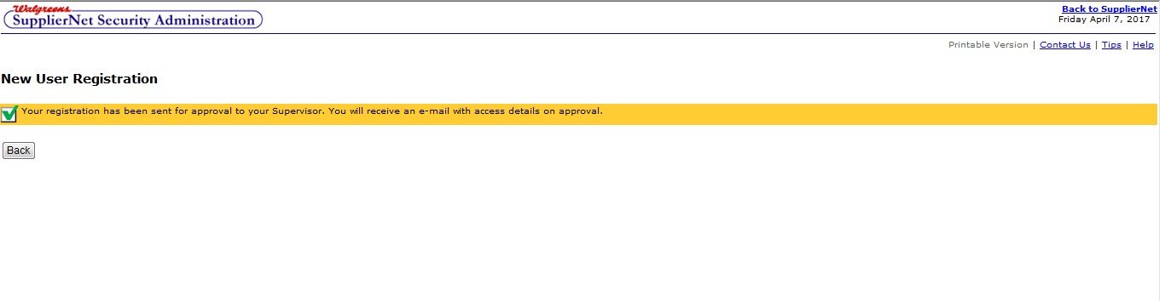
New Supplier Account Registration, Updates & Support
Steps for Registering as a new user
7. Once you submit your registration request you will be taken to a confirmation screen.
8. Although the screen reflects “Supervisor”, it’s your “account administrator”. The account administrator will receive an email from VendorSetup.Support@walgreens.com with the next steps and a link to complete your registration. After administrator approval, the user credentials will be sent to the registered email address. DO NOT reply to the VendorSetup.Support@walgreens.com email, it is not monitored.

Slide 38
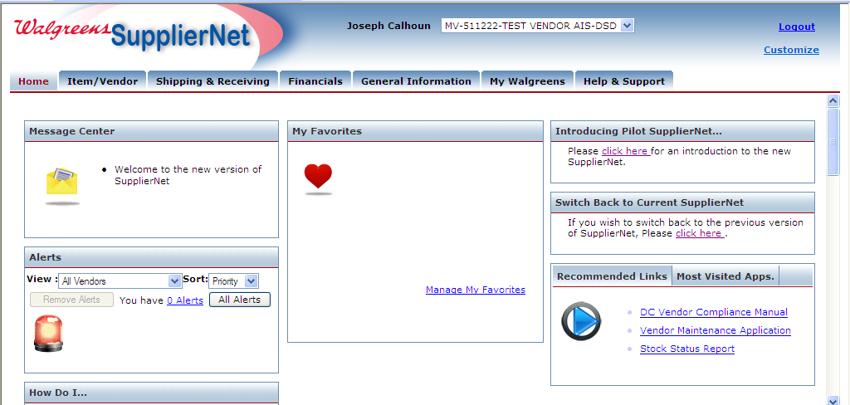
New Supplier Account Registration, Updates & Support
Updating Existing Access
Follow these steps if you need to request additional vendor access to Walgreens applications.
Note: You must be a registered user to complete this action
1. Login to SupplierNet (https://suppliernet.walgreens.com) and select the ‘My Walgreens’ tab.

Slide 39
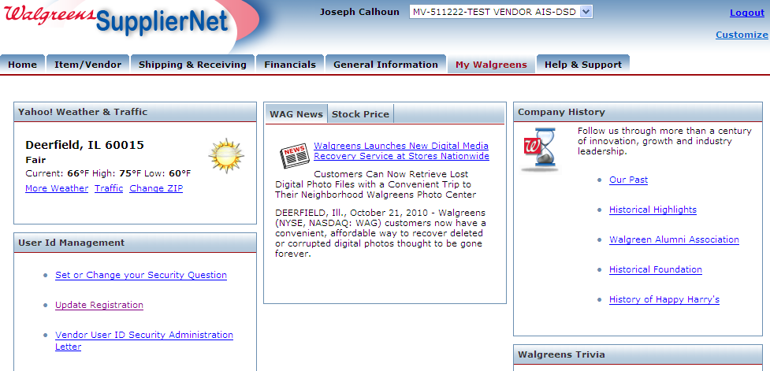
New Supplier Account Registration, Updates & Support
Updating Existing Access
2. Click the ‘Update Registration’ link.

Slide 40
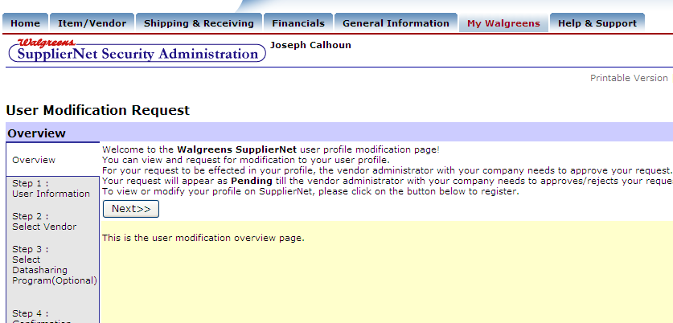
New Supplier Account Registration, Updates & Support
Updating Existing Access
3. Click ‘Next’

Slide 41
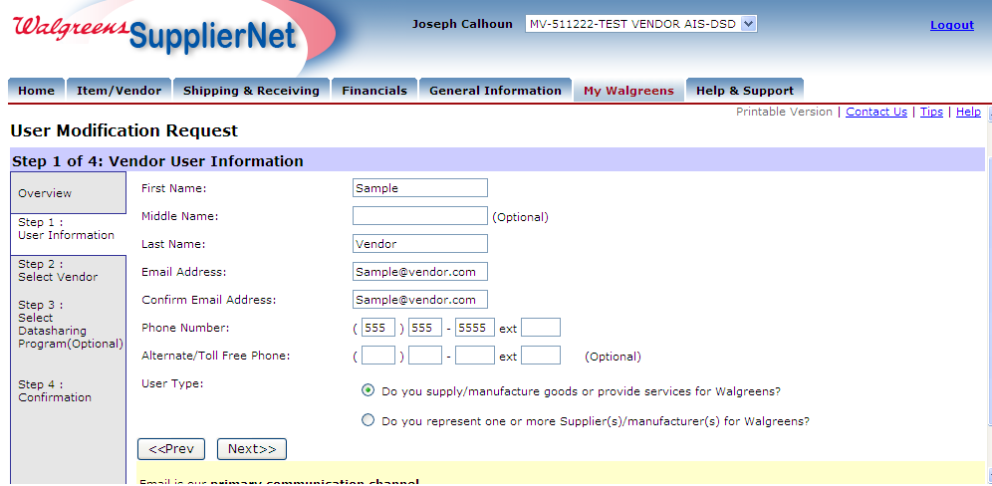
New Supplier Account Registration, Updates & Support
Updating Existing Access
4. Type in email address on both lines and fill in your phone number and then click ‘Next’.

Slide 42
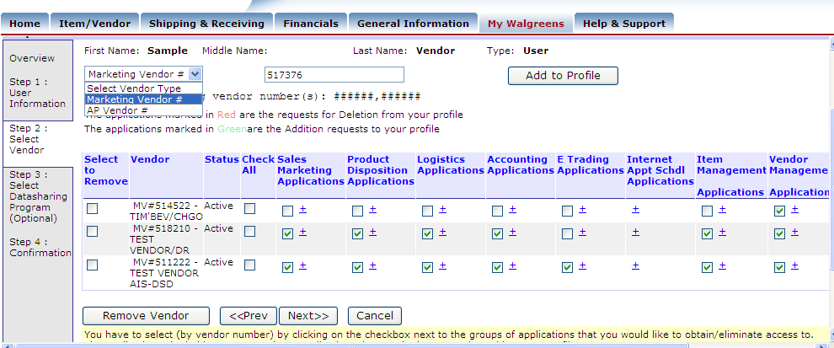
New Supplier Account Registration, Updates & Support
Updating Existing Access
5. Select ‘Marketing Vendor #’ from the drop-down screen and enter your six-digit vendor number. If you do not know your marketing vendor number, please ask your Walgreens Merchant partner. You can separate up to five marketing vendor numbers with a comma. Click ‘Add to Profile’.

Slide 43
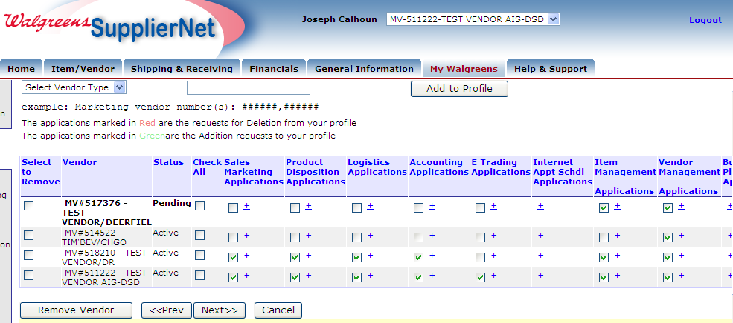
New Supplier Account Registration, Updates & Support
Updating Existing Access
6. Check all applications you need access to then click ‘Next’.

Slide 44
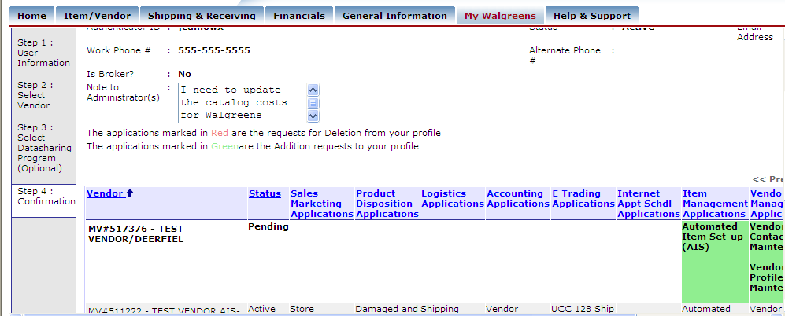
New Supplier Account Registration, Updates & Support
Updating Existing Access
7. The last step is to confirm your registration request. You have the option to include a comment to be sent to your company’s Vendor Administrator. Scroll to the bottom and click ‘Confirm Changes’. The Vendor Administrator will receive an email prompting them to review and approve your request.

Slide 45
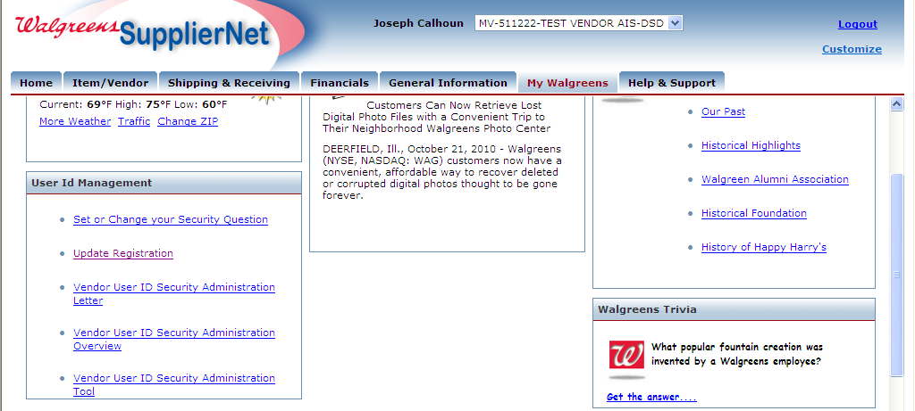
New Supplier Account Registration, Updates & Support
Administrator Approval Steps
1. Only your administrator can review your request. Go to the ‘My Walgreens’ tab. Click on the ‘Vendor User ID Security Administration Tool’ link.

Slide 46
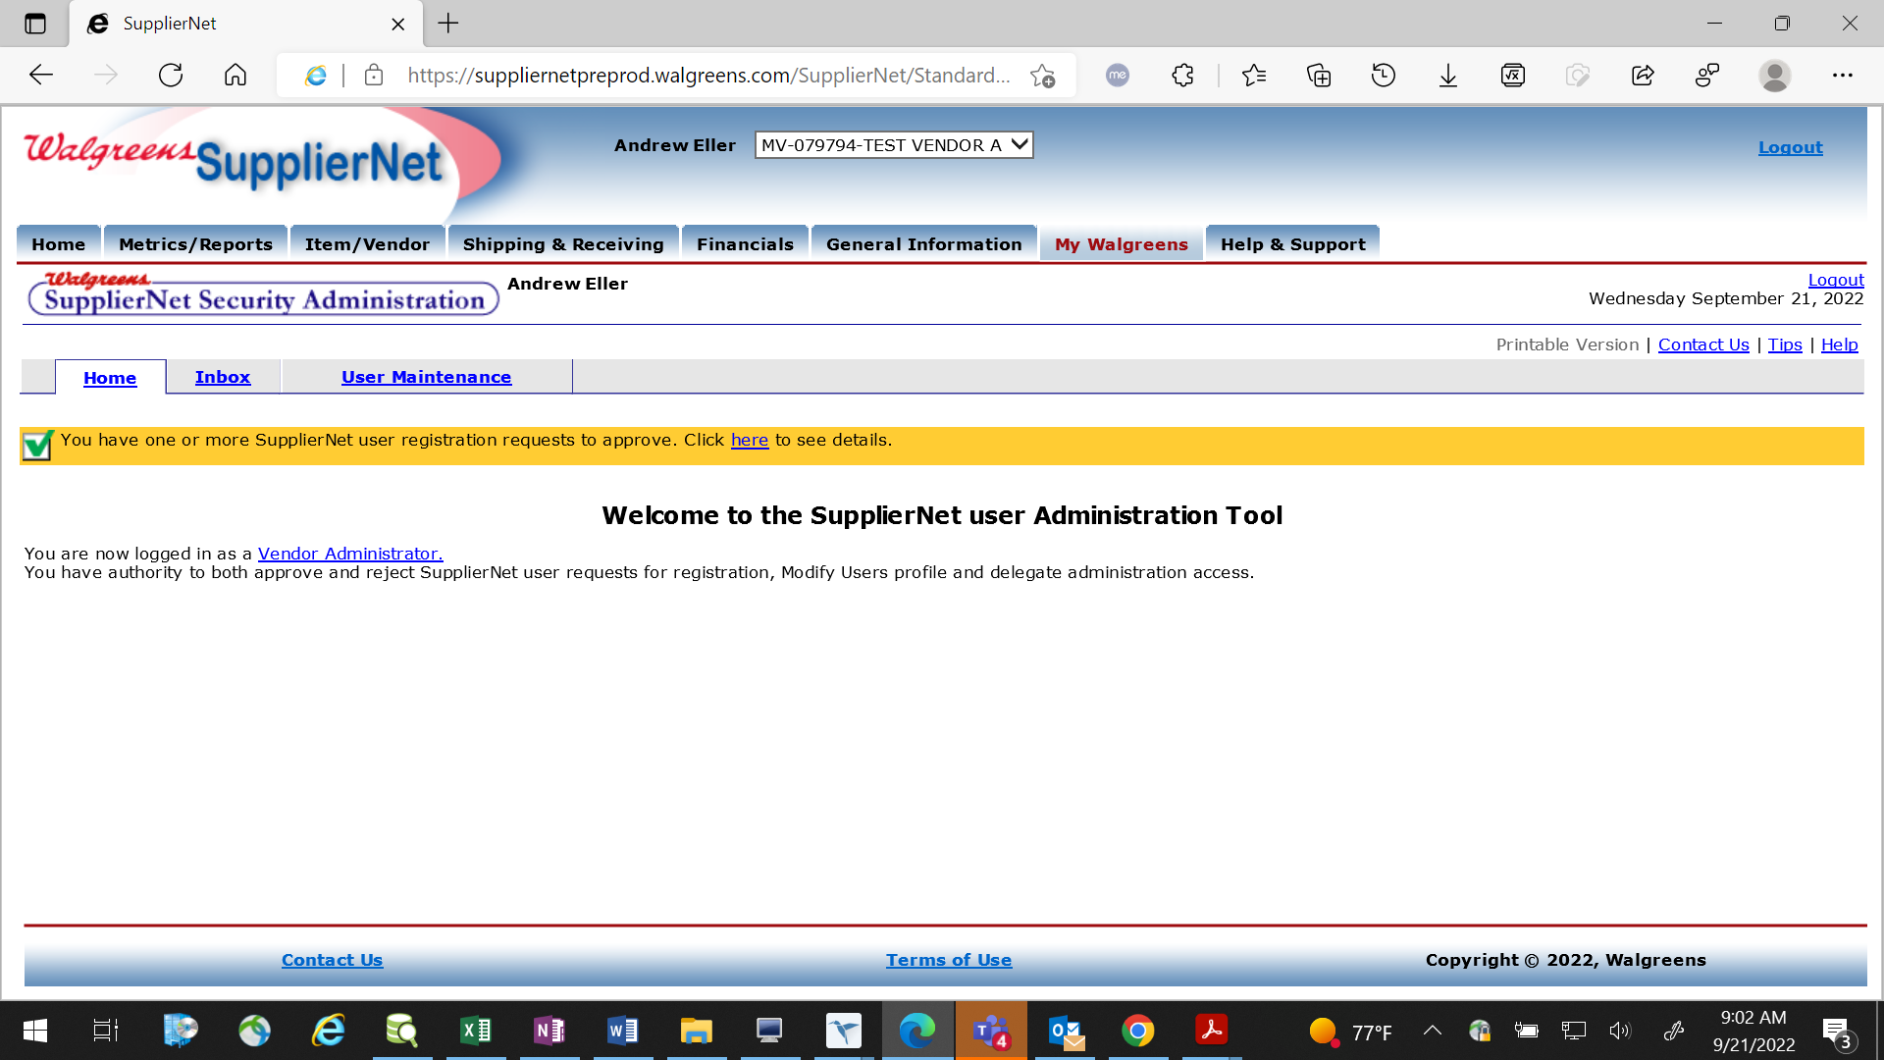
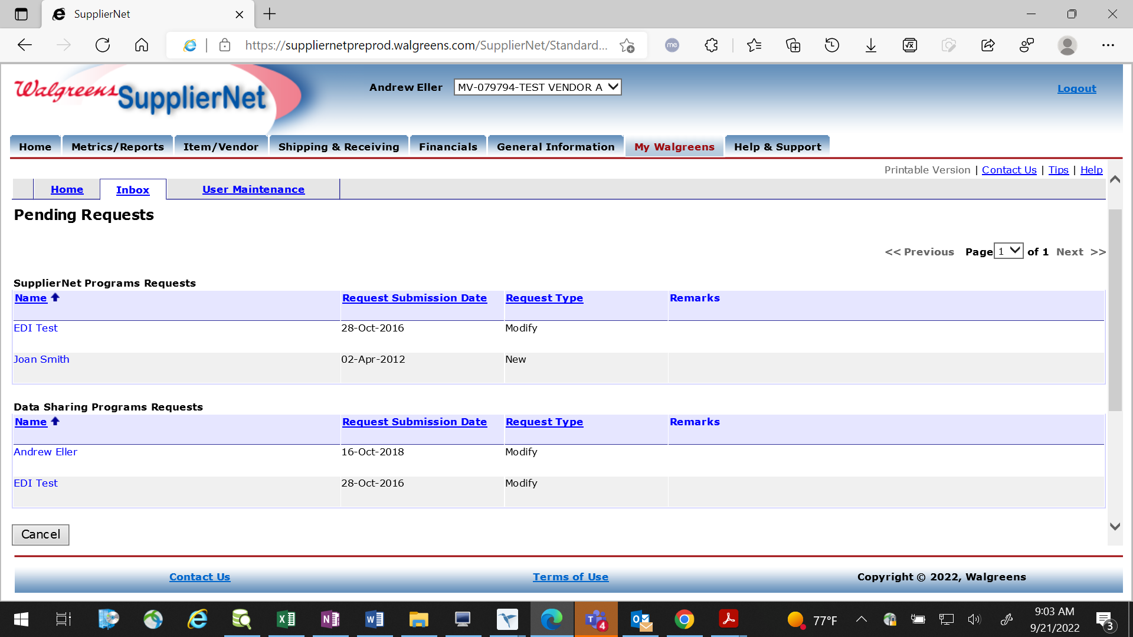
New Supplier Account Registration, Updates & Support
Administrator Approval Steps
2. Click on the ‘here’ link to review any pending requests.
3. All pending requests will be housed on this screen. Click on the name to review the request.

Slide 47
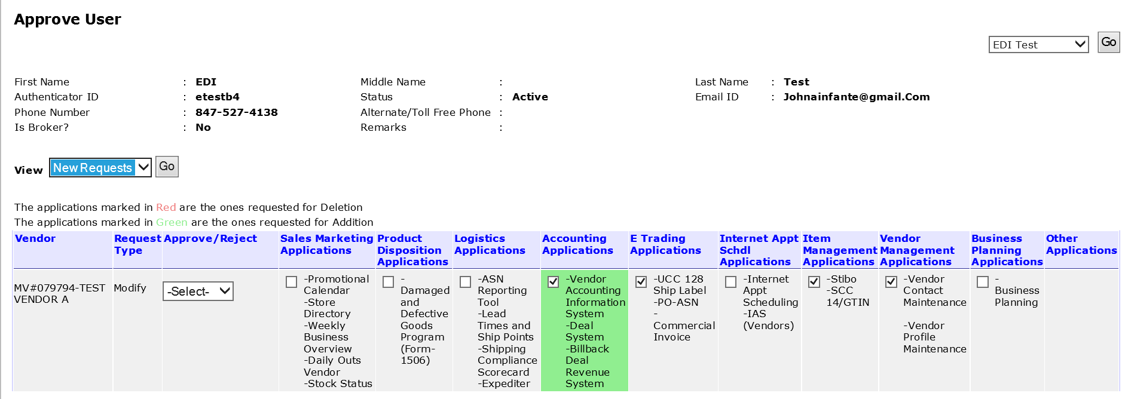
New Supplier Account Registration, Updates & Support
Administrator Approval Steps
4. Review the pending changes then click ‘Confirm Approvals’.

Slide 48
New Supplier Account Registration, Updates & Support
Obtaining SupplierNet Support
Go to SupplierNet (https://suppliernet.walgreens.com)
For assistance with SupplierNet, including password resets, you can submit a ticket by following Contact Us > Contact Help Center
Follow the contact us form prompts and include a detailed description of the issue. Answering all of the information up front will help your issue get to the correct team.
Note: Attaching a screenshot of the issue will help expedite a resolution to the problem.

Slide 49
New Supplier Account Registration, Updates & Support
Response from SupplierNet Support
1. You will receive an email from requestit@walgreens.com. Please be sure to add this to your address book to avoid landing in your spam folder.
2. If you submitted a ticket for a password reset, the temporary password is only valid for 48 hours after being sent by IT support, so be sure to look out for the email so that you can use it before it expires.
3. If you submitted a ticket for another issue and the support team needs more information you may receive an email from requestit@walgreens.com asking you to respond (using specific directions in the body of the email). Please follow the directions on how to respond promptly. Please note, after your initial request is received, your ticket will remain open for five (5) days after requestIt has been responded so be sure to reply as soon as possible.

Slide 50
New Supplier Account Registration, Updates & Support
Please follow the below rules for password changes:
  The password you make up when you arrive at the Authenticator screen must be between 8 and 20 alphanumeric characters (no special characters).
  The password must begin and end in a letter and must contain at least one embedded numeric (e.g. Go2work or Webm5aster or Administr8or).
  Passwords must not have the numeric at the very beginning nor the very end of the password.
  The new password may not be the same as the current previous or previous password.
  The user password should have at least one upper case.
5. You should hear back from our Vendor Portal support team within 2 days. If you do not hear them, please send an email with your ticket number to vendor.portal@walgreens.com for escalation. If you get no response, experience any other issues, do not have an id, or do not know your account administrator or the email you registered with, please reach out to your Walgreens Merchandising contact.

Slide 51
Appendix
Vendor Maintenance and updating contact information

Slide 52
Guidelines for Updating Company Contacts in SupplierNet
All Walgreens communication is sent to the email addresses in your contact information on SupplierNet. If you fail to keep your contacts up to date, you will miss important communication including time-sensitive notifications to avoid payment delays, advance ship notice (ASN) failures, WIC Generations, etc.
Best Practices:
• To ADD/UPDATE your EDI contact information, please email EDI810.Production@walgreens.com.
• Payment Remittance Address and overall contact information can be updated in the Vendor Maintenance Application (VMA) which can be accessed via SupplierNet.
• Due to the high turnover of personnel with our suppliers, Walgreens highly recommends establishing an email box vs using an individual email address as the contact for payment concerns i.e. support@company.com.

Slide 53
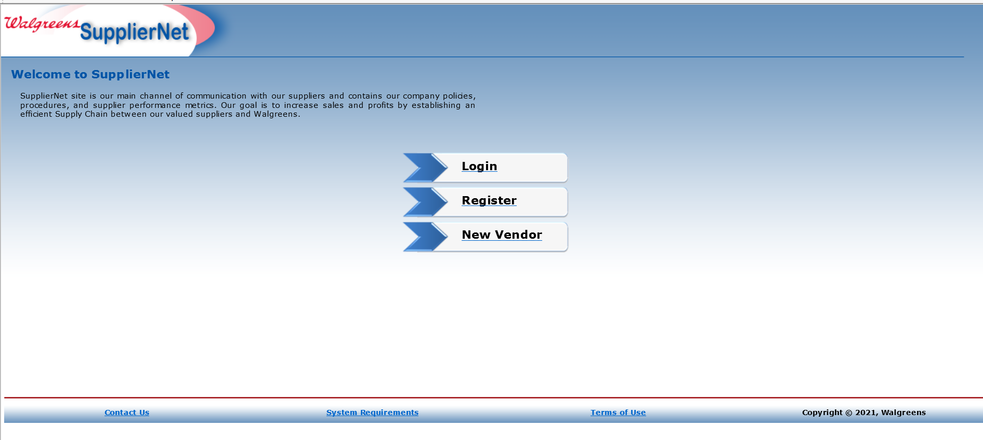
Guidelines for Updating Company Contacts in SupplierNet
Steps to Update Company Contacts
1. Login to SupplierNet (https://suppliernet.walgreens.com)

Slide 54
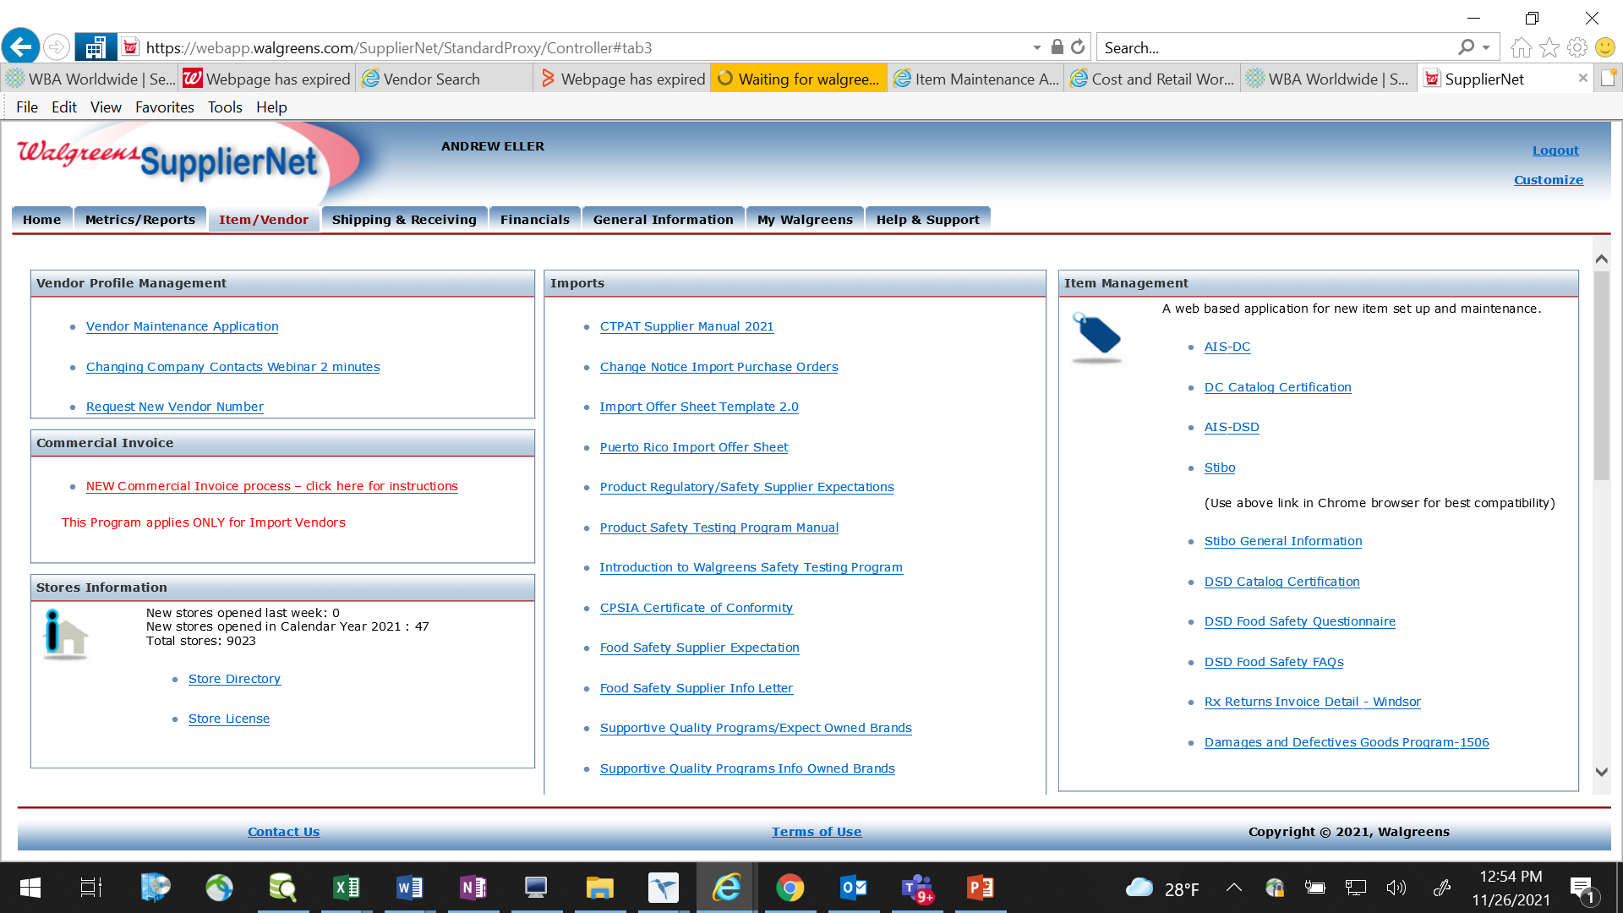
Guidelines for Updating Company Contacts in SupplierNet
Steps to Update Company Contacts
2. Navigate to the Item/Vendor tab then click on Vendor Maintenance Application link.

Slide 55
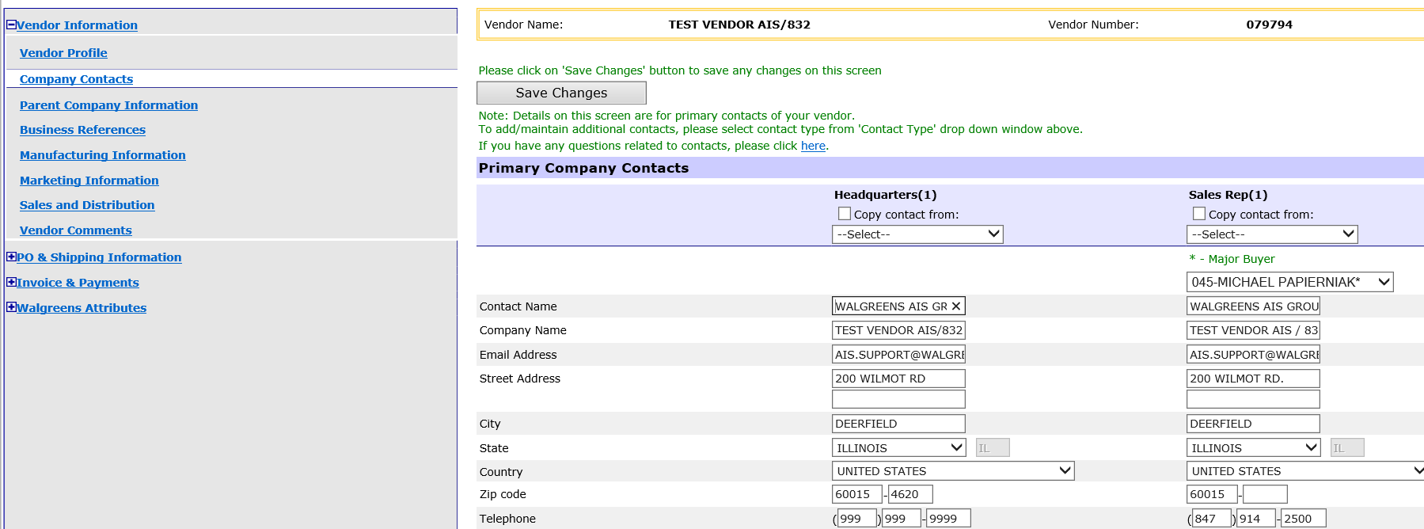
Guidelines for Updating Company Contacts in SupplierNet
Steps to Update Company Contacts
3. Click on the Company Contacts tab once you are in the Vendor Maintenance Application. The Company Contacts page is where you maintain all of the vendor contact information.
To update the contact information for a primary contact:
  Update the information under the contact type Primary Contacts and click Save Changes.

Slide 56
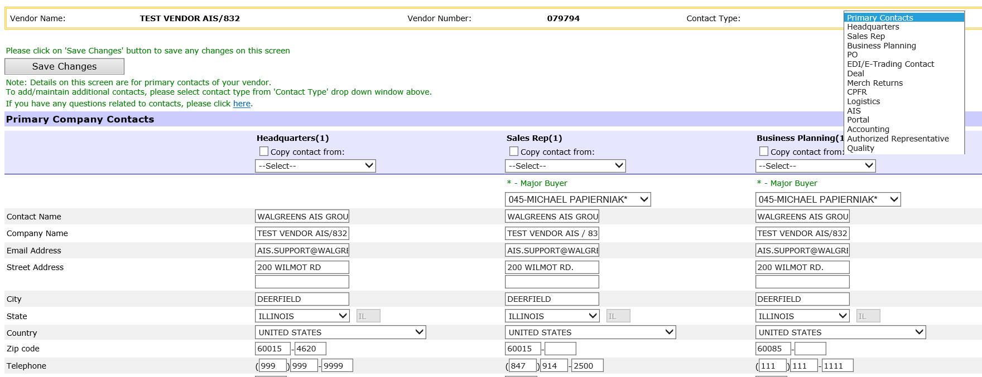
Guidelines for Updating Company Contacts in SupplierNet
Steps to Update Company Contacts
4. To view all contacts (primary and secondary) for other contact types:
  Use the Contact Type dropdown in the upper right-hand corner and select the contact type. This will take you to the additional contacts.

Slide 57
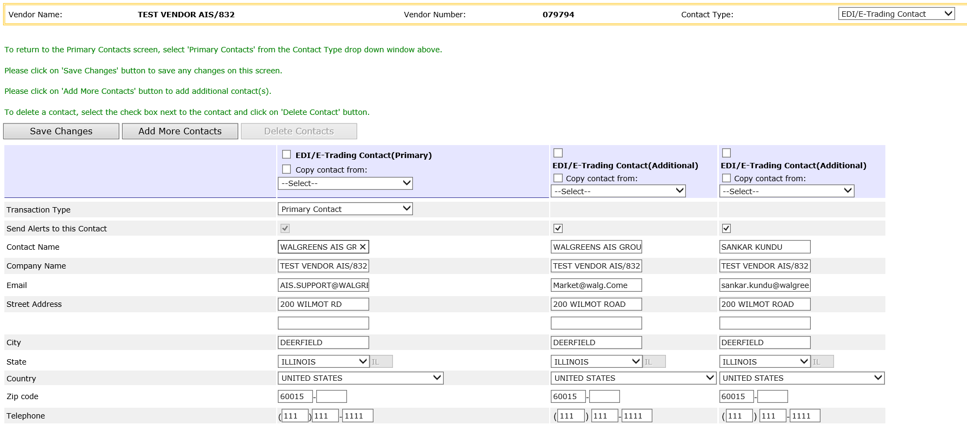
Guidelines for Updating Company Contacts in SupplierNet
Steps to Update Company Contacts

Slide 58
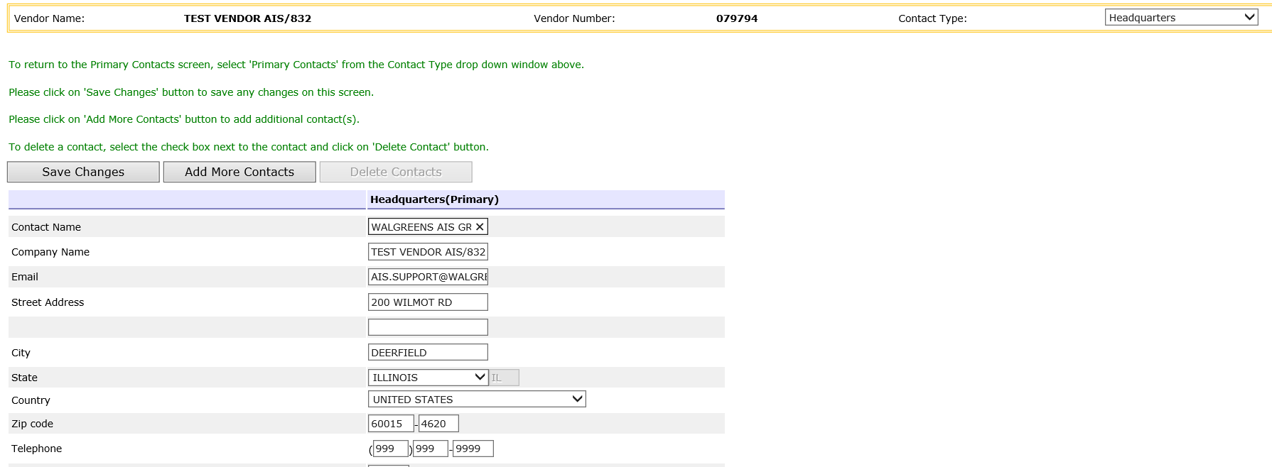
Guidelines for Updating Company Contacts in SupplierNet
Steps to Update Company Contacts
To add an additional contacts:
Click Add More Contacts, enter the contact information then click Save Changes.
To update current contact information shown:
Make changes and click Save Changes.

Slide 59
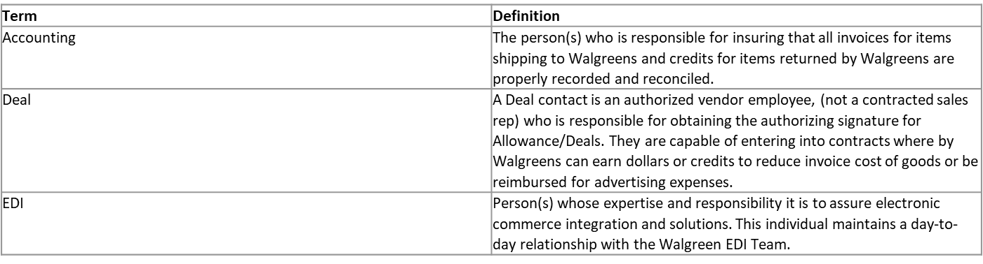
Guidelines for Updating Company Contacts in SupplierNet
Deleting Contacts
We highly recommend suppliers clean out their old contacts before adding new ones. If old contacts are still in the system they will continue to be sent emails.
To delete any contacts, please open a ticket by following Contact Us > Contact Help Center
Company Contacts Glossary

Slide 60
Appendix
Vendor Numbers

Slide 61
What are my vendor numbers?
A Marketing Vendor (MV) number is a 6-digit number assigned to a vendor for identification purposes. The Marketing Vendor number is a legacy term used to manage vendor maintenance, ordering, SupplierNet, etc. DSD MV numbers will always begin with a '0' or '5' while DC MV numbers will begin with anything other than a ‘5’.
SAP Vendor numbers are used for item proposals, maintenance, and cost information in Stibo and to ensure that stores can properly receive your merchandise. If you represent more than one Supplier (e.g., Brokers, etc.), you have the option to toggle to the correct SAP Supplier Number in Stibo. Please note, the Supplier (Vendor) Number that is assigned in Stibo is your SAP Supplier Number; NOT the Marketing Vendor number that you may be familiar with in legacy systems.
The AP number is an account payable number that is used for invoicing and payment data. The Legacy and SAP systems each have unique vendor numbers. The reference to AP# and Invoice Party # are the same. With the SAP transition, all supplier AP#’s now have an equivalent Invoicing Party #. These are the numbers that AP uses to make payments to each supplier.
* If you do not know your vendor number(s), please work with your Merchant/RPC contact.

Slide 62
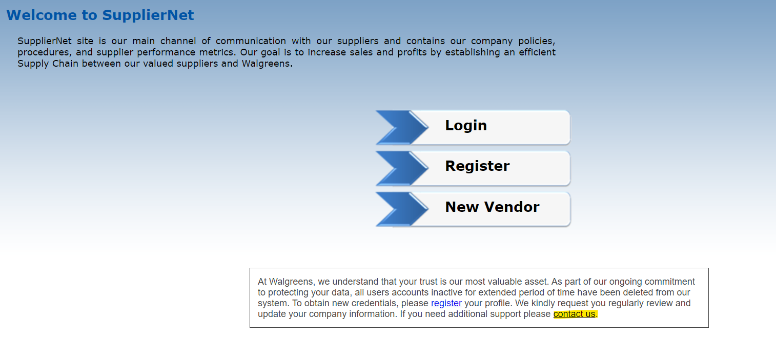
What if I don’t see my supplier ID in Stibo?
The vendor portal team advises following the steps below to ensure the quickest resolution time for your login issues.
For any Login issues for STIBO or SupplierNet, please open a ticket in SupplierNet by clicking on the "Contact Us" link at the bottom of the SupplierNet website. It is important to note that users are not required to login in order to submit a ticket.
If you encounter difficulties while trying to open a ticket, you can send an email to vendor.portal@walgreens.com. In your email, please include a screenshot of the issue you are facing, and the team will provide assistance in the process of opening a ticket.
If you do not receive a timely reply from 'Request IT' or Vendor Portal regarding your ticket, you can email mdmenablement@walgreens.com with your ticket number.

